Slide 1
Attention Please!
Attention Mechanisms in Neural Networks
Patrick Michl www.frootlab.org
PyData Heidelberg #4 2019-11-21

Slide 2
Milestones in Attention Research
since 1990s
Visual Attention in Human Perception

Slide 3
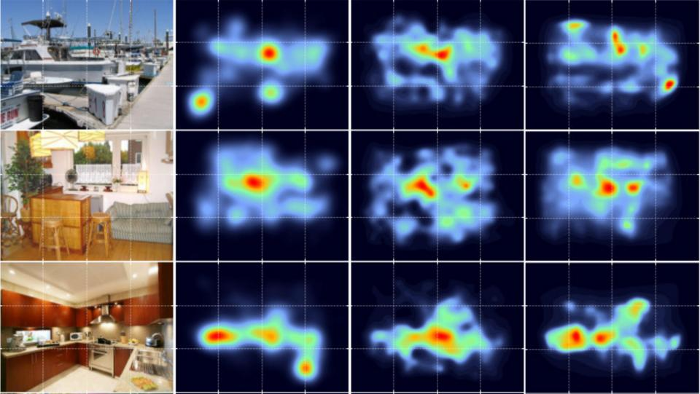
Visual Attention in Human Perception
Visual attention in human perception is based on the dynamics between Recognition and Selection
Image source: John Henderson and Taylor Hayes, UC Davis

Slide 4
Visual Attention in Image Captioning
since 1990s
since 2014
Visual Attention in Human Perception

Slide 5
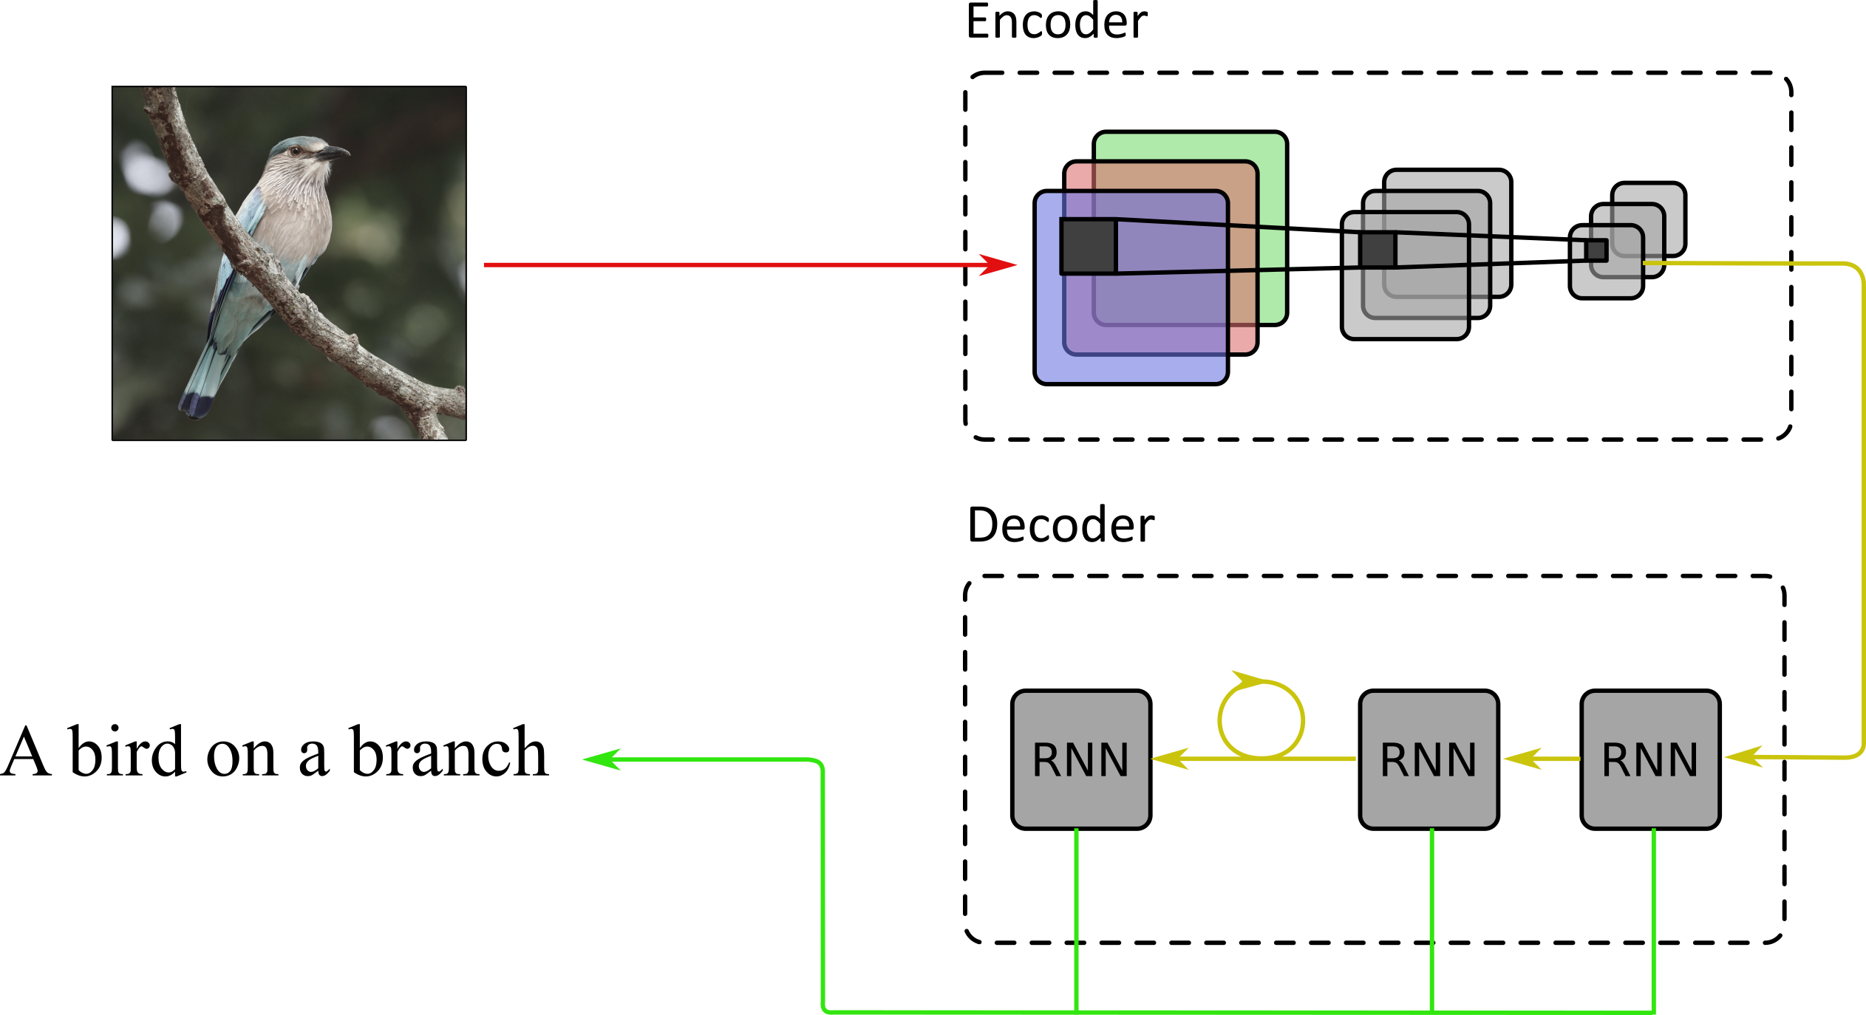
Visual Attention in Image Captioning
Architecture
Encoder: CNN
Decoder: RNN

Slide 6
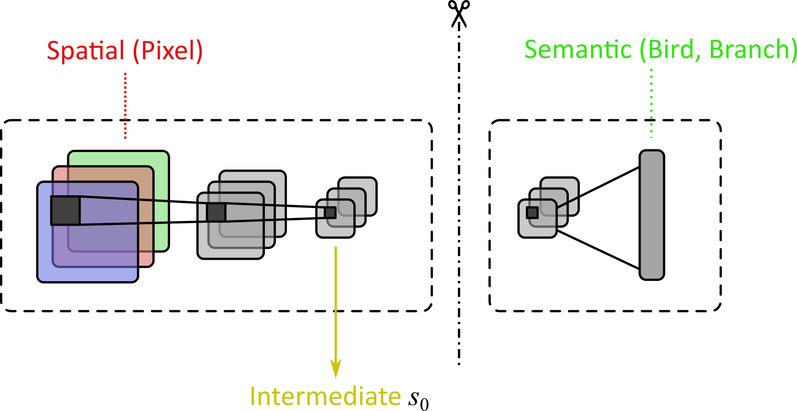
Visual Attention in Image Captioning
Encoder
Encoder: CNN
Convolutional features entangle spatial with semantic information
Decoder: RNN

Slide 7
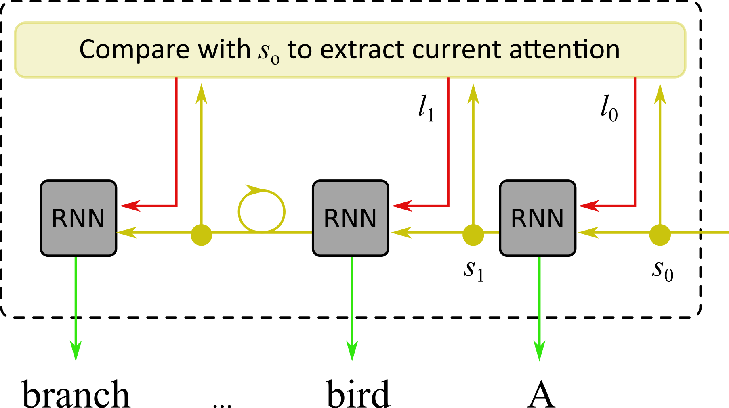
Visual Attention in Image Captioning
Decoder
Encoder: CNN
Convolutional features entangle spatial with semantic information
Decoder: RNN
Visual Attention allows to recover spatial relations of current outputs

Slide 8
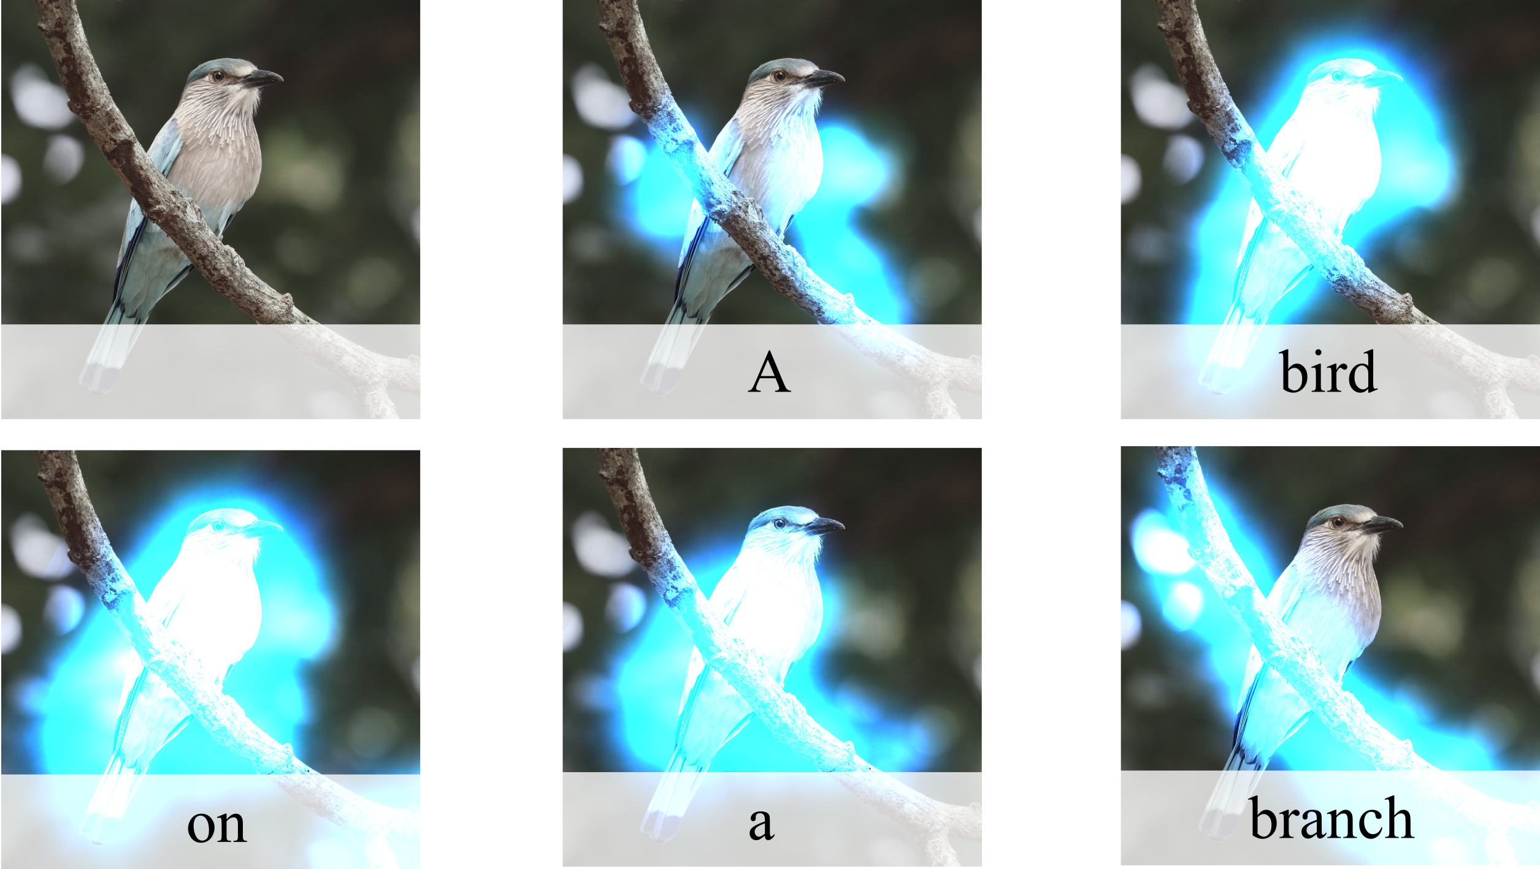
Visual Attention in Image Captioning
Encoder: CNN
Convolutional features entangle spatial with semantic information
Decoder: RNN
Visual Attention allows to recover spatial relations of current outputs

Slide 9
Visual Attention in Image Captioning
since 1990s
since 2014
since 2015
Visual Attention in Human Perception
Global Attention in Machine Translation

Slide 10
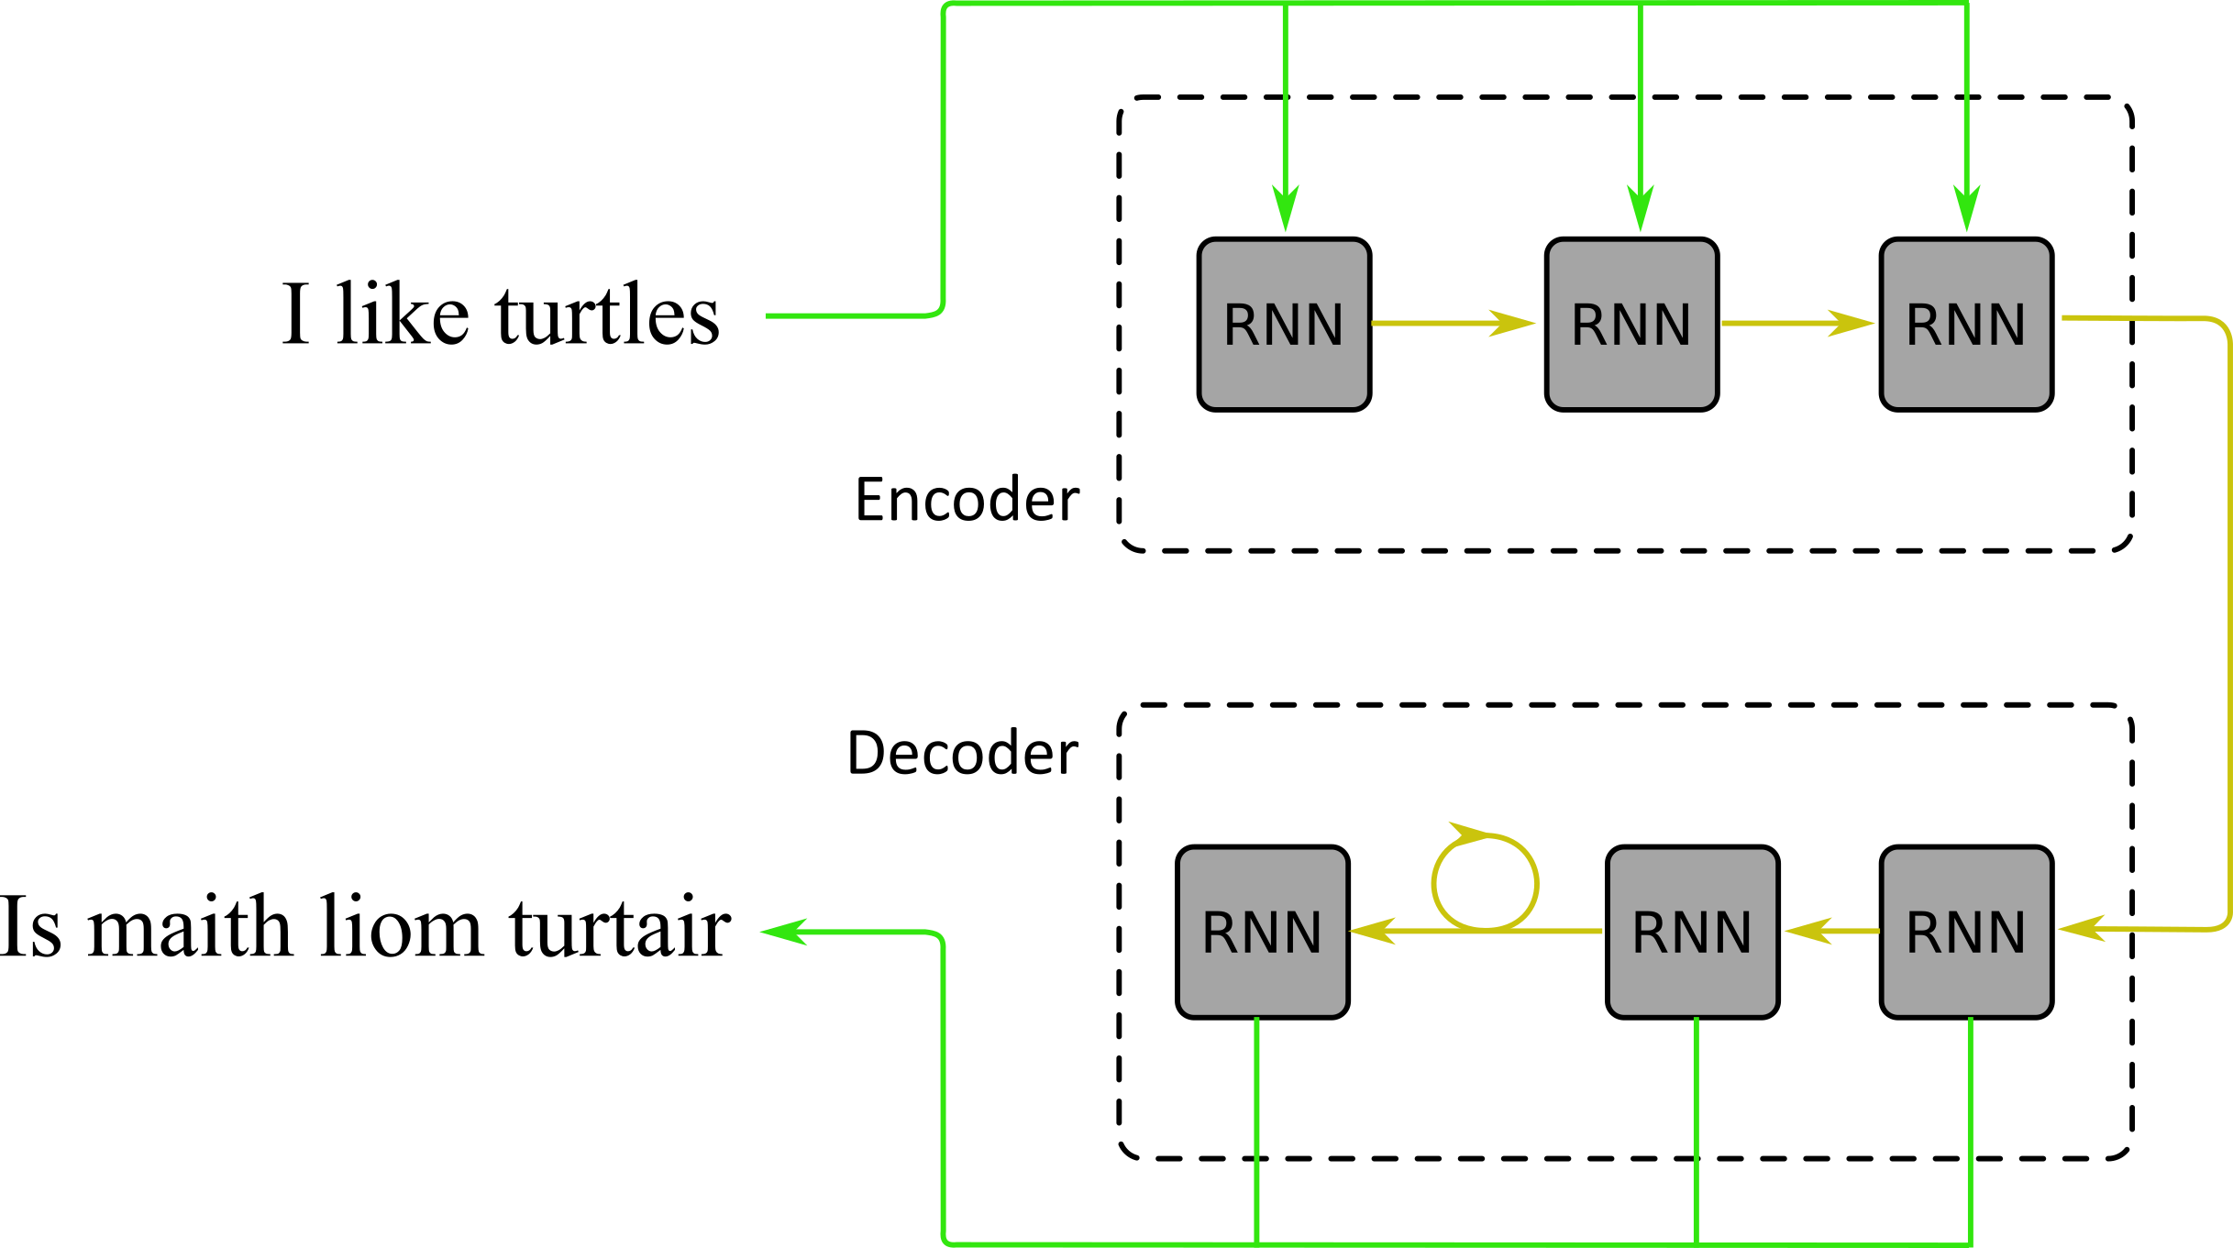
Global Attention in Machine Translation
Architecture
Encoder: RNN
Decoder: RNN

Slide 11
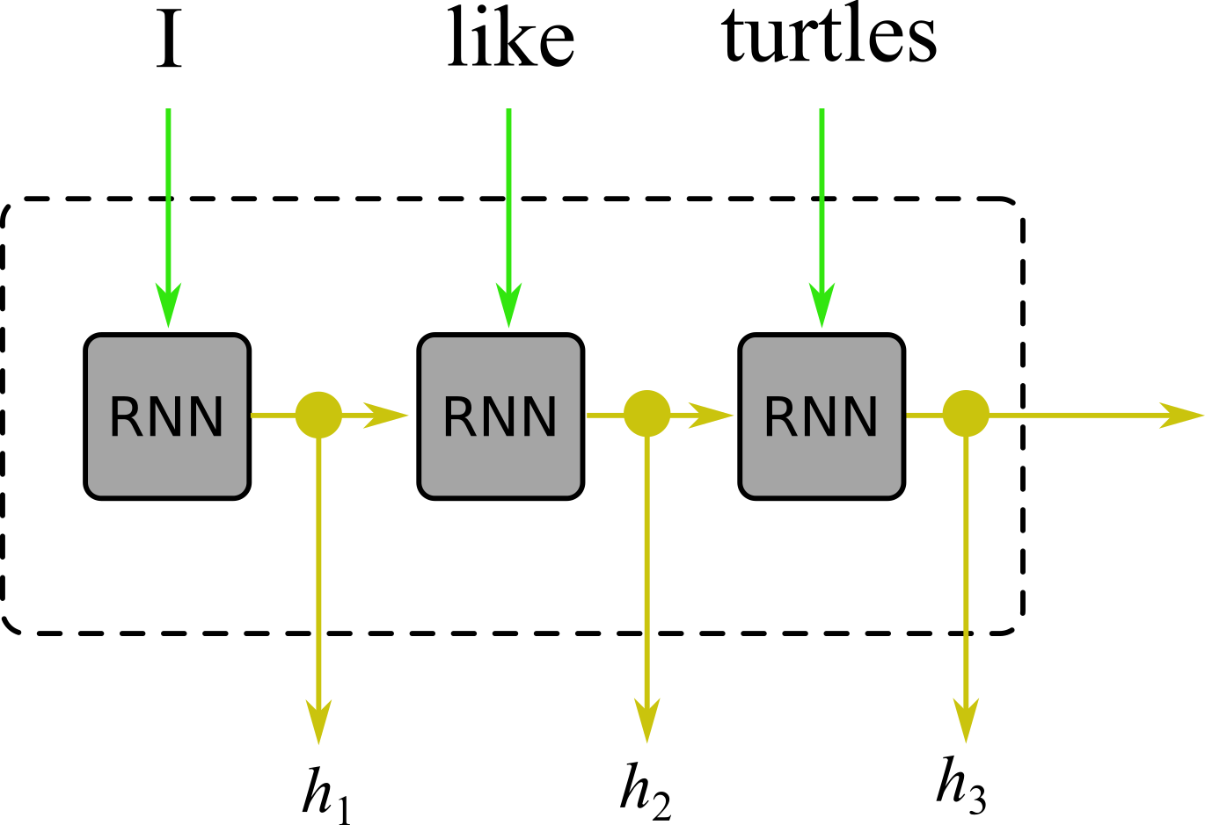
Global Attention in Machine Translation
Encoder
Encoder: RNN
Sequence of hidden states encodes the context building stack
Decoder: RNN

Slide 12
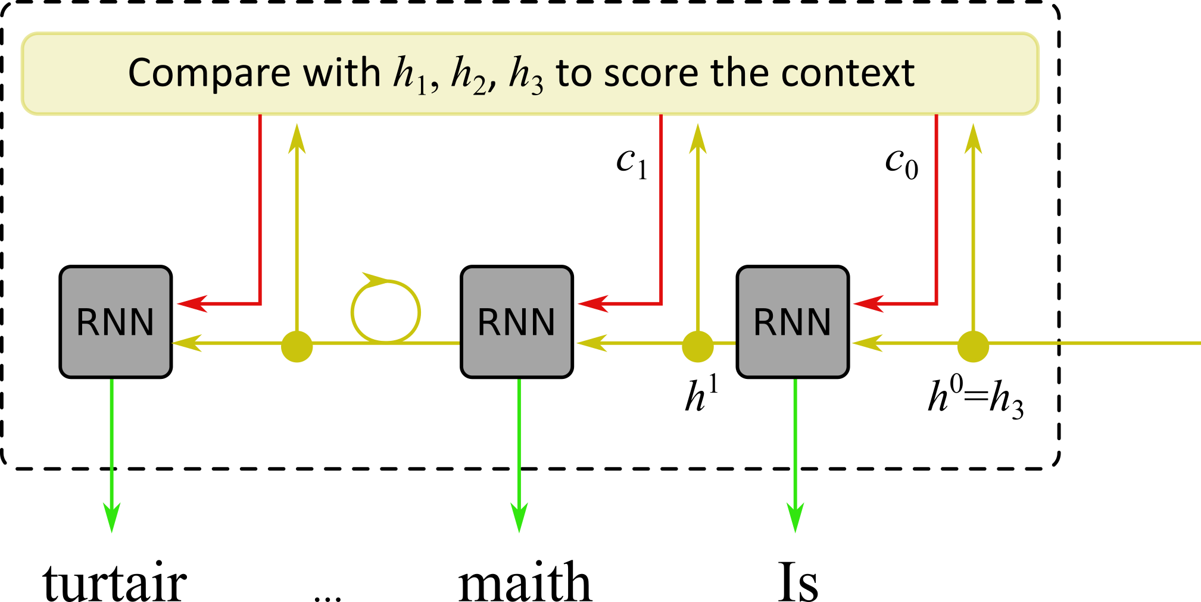
Global Attention in Machine Translation
Decoder
Encoder: RNN
Sequence of hidden states encodes the context building stack
Decoder: RNN
Global Attention allows to recover the context of current outputs

Slide 13
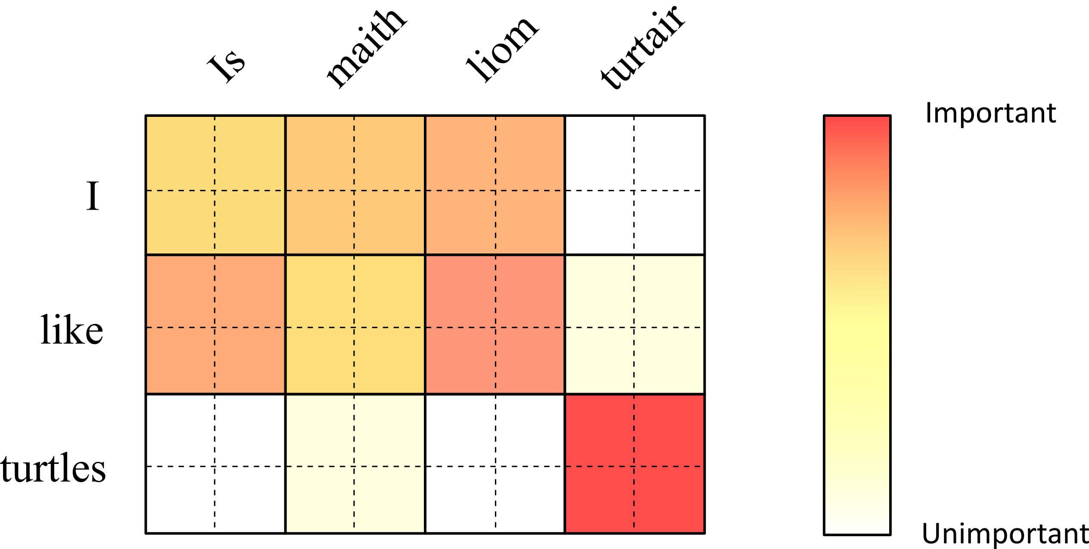
Global Attention in Machine Translation
Context
Encoder: RNN
Sequence of hidden states encodes the context building stack
Decoder: RNN
Global Attention allows to recover the context of current outputs

Slide 14
Visual Attention in Image Captioning
Multi-Step Attention in Natural Language Processing
since 1990s
since 2014
since 2015
since 2016
Visual Attention in Human Perception
Global Attention in Machine Translation

Slide 15
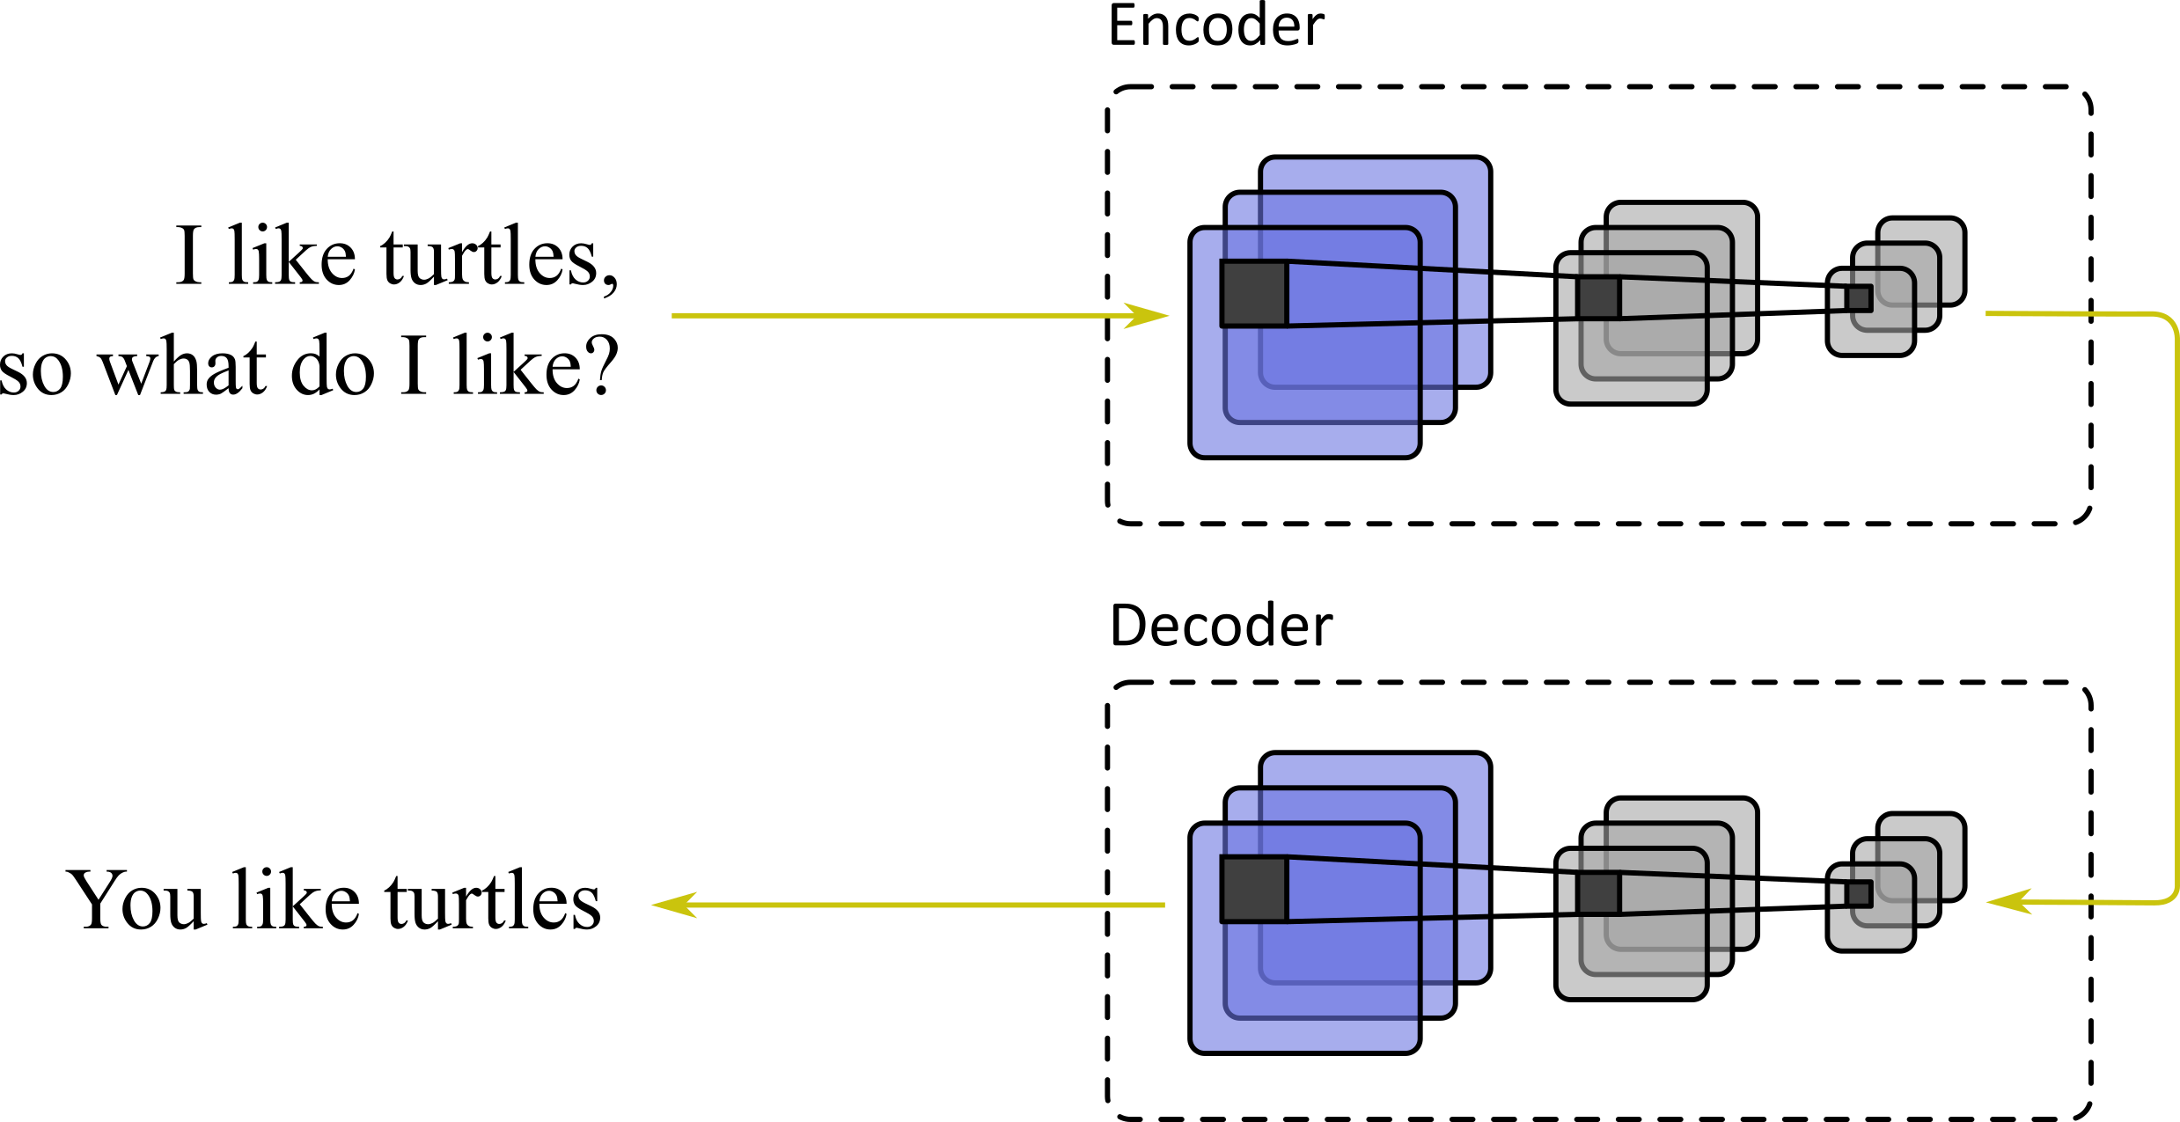
Multi-Step Attention in Natural Language Processing
Architecture
Encoder: CNN
Decoder: CNN

Slide 16
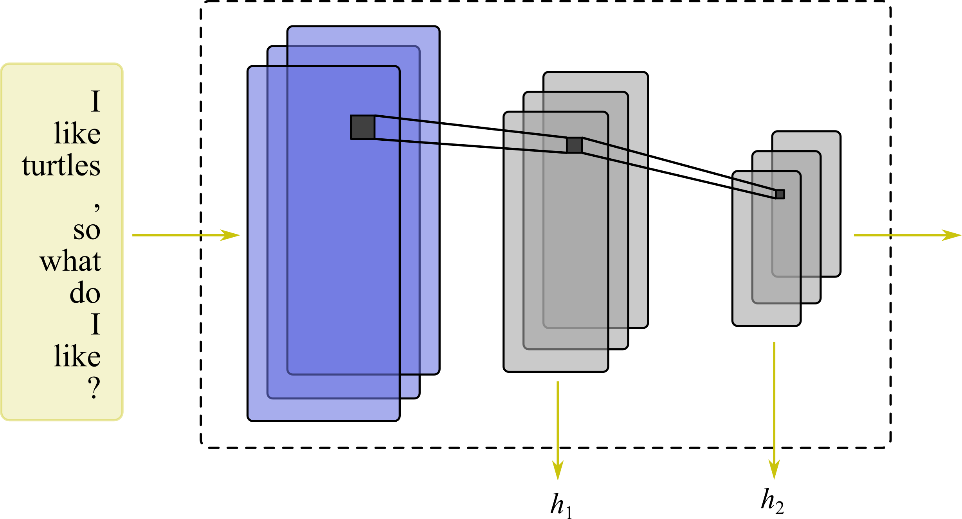
Multi-Step Attention in Natural Language Processing
Encoder
Encoder: CNN
Sequence of convolutional features encodes the context building stack
Decoder: CNN

Slide 17
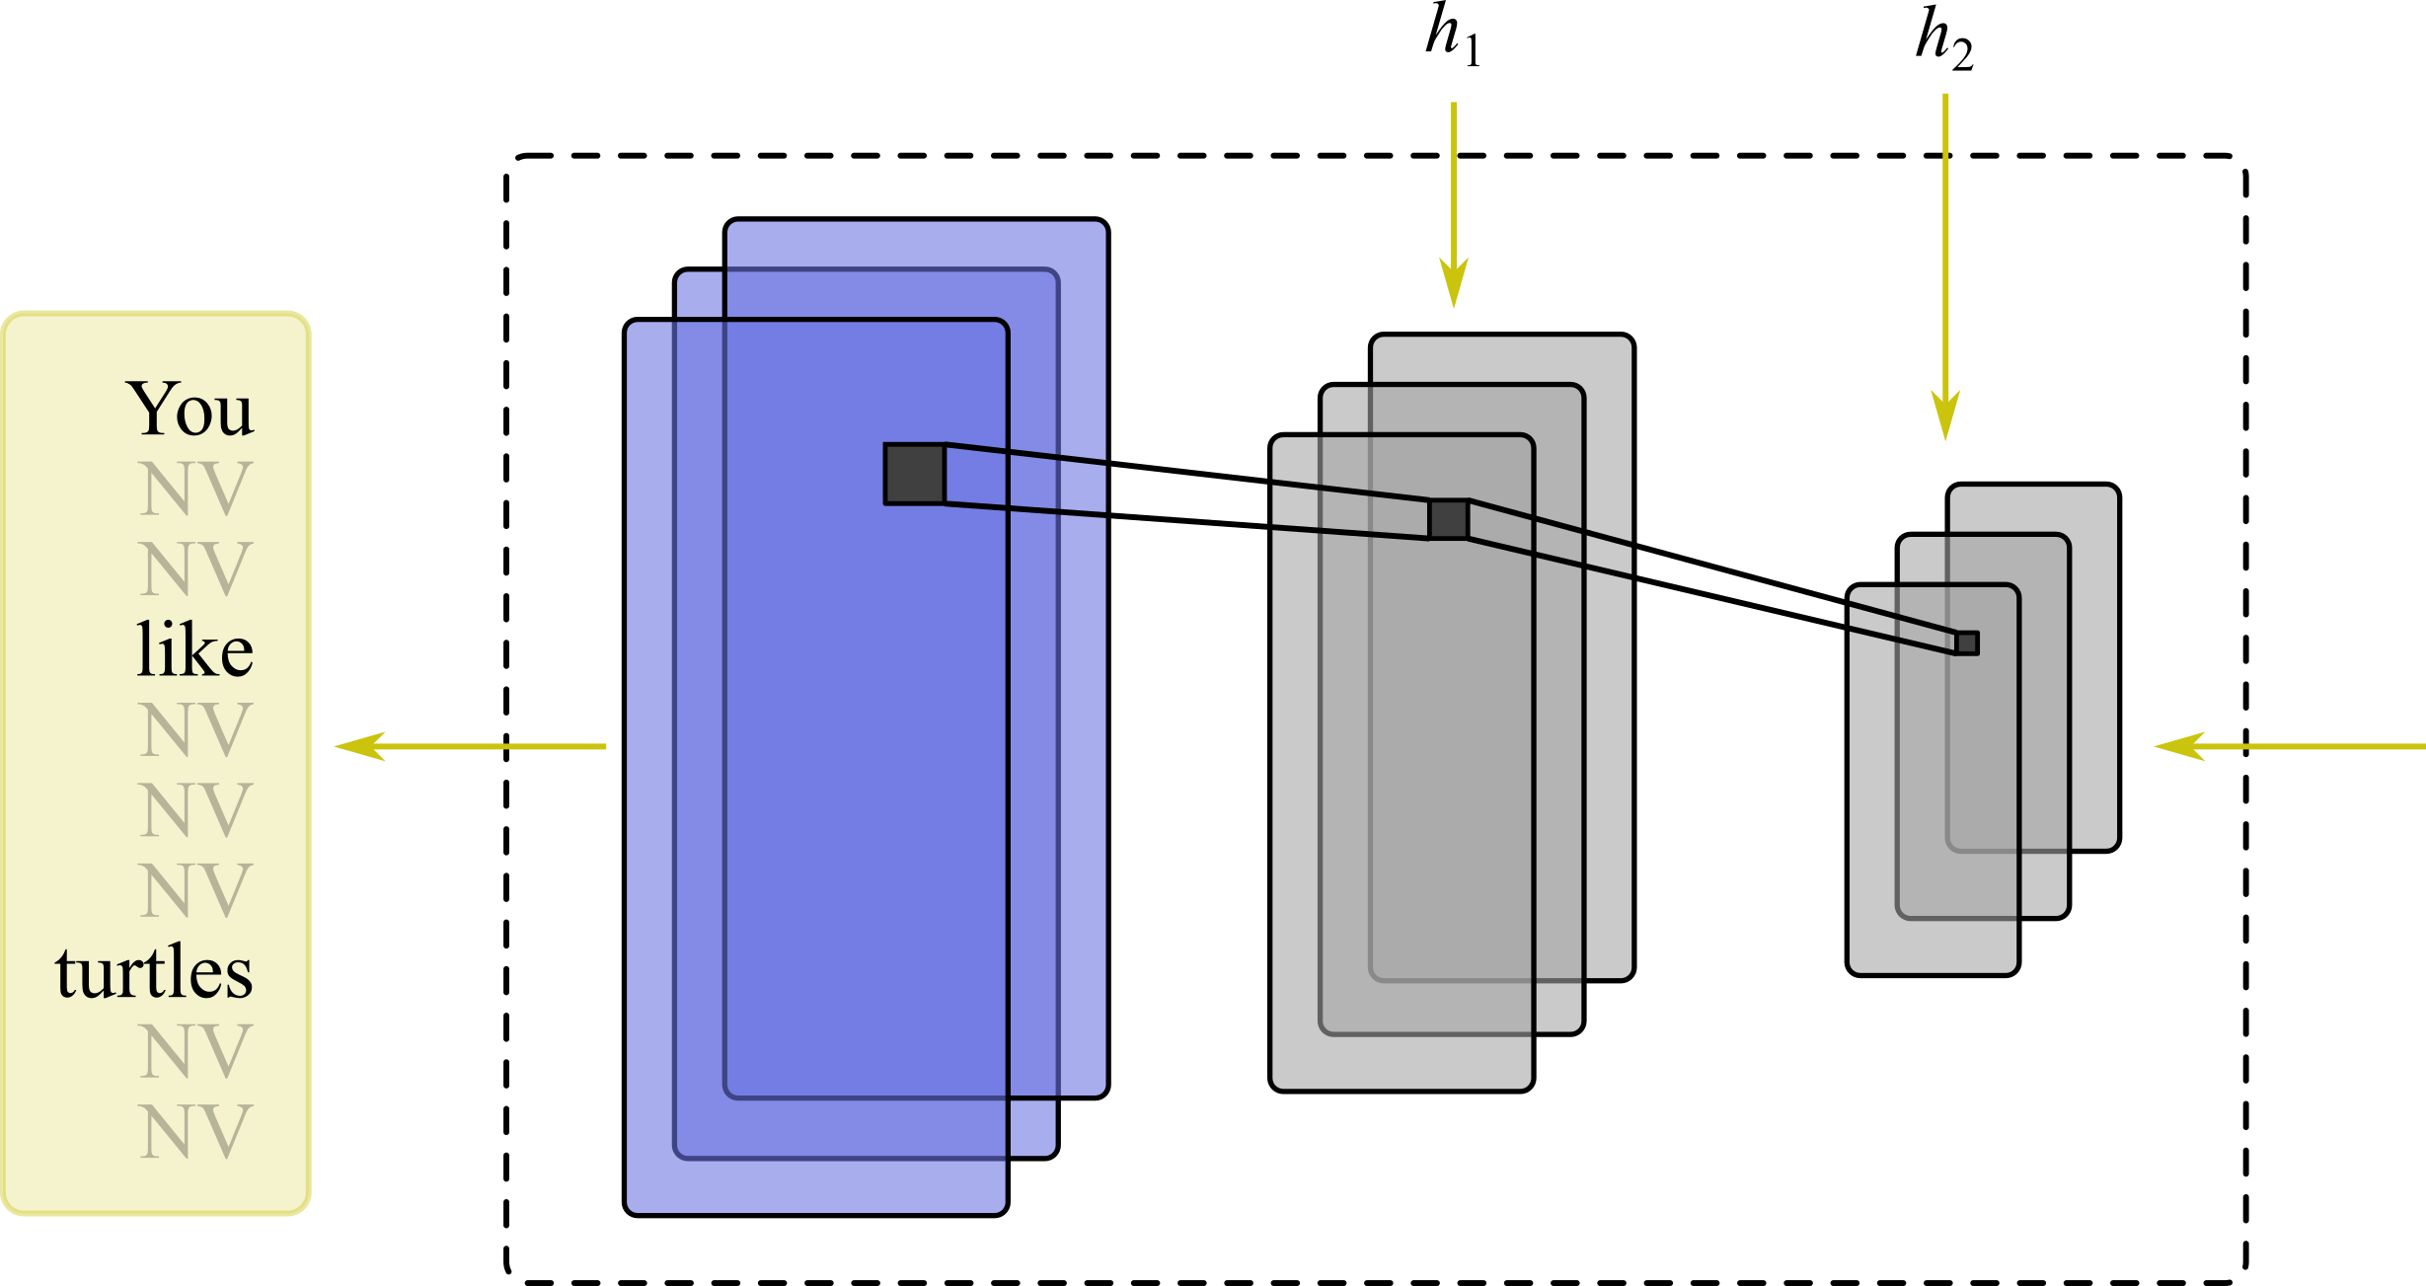
Multi-Step Attention in Natural Language Processing
Decoder
Encoder: CNN
Sequence of convolutional features encodes the context building stack
Decoder: CNN
Multi-Step Attention allows to recover the current context of current deconvolutional steps

Slide 18
Visual Attention in Image Captioning
Multi-Step Attention in Natural Language Processing
since 1990s
since 2014
since 2015
since 2016
since 2017
Visual Attention in Human Perception
Global Attention in Machine Translation
Self-Attention in Natural Language Processing

Slide 19
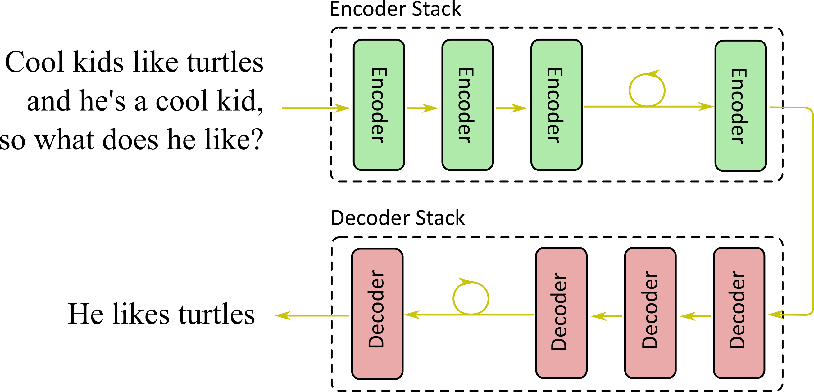
Self-Attention in Natural Language Processing
Architecture
Encoder: Stacked ANN
Decoder: Stacked ANN

Slide 20
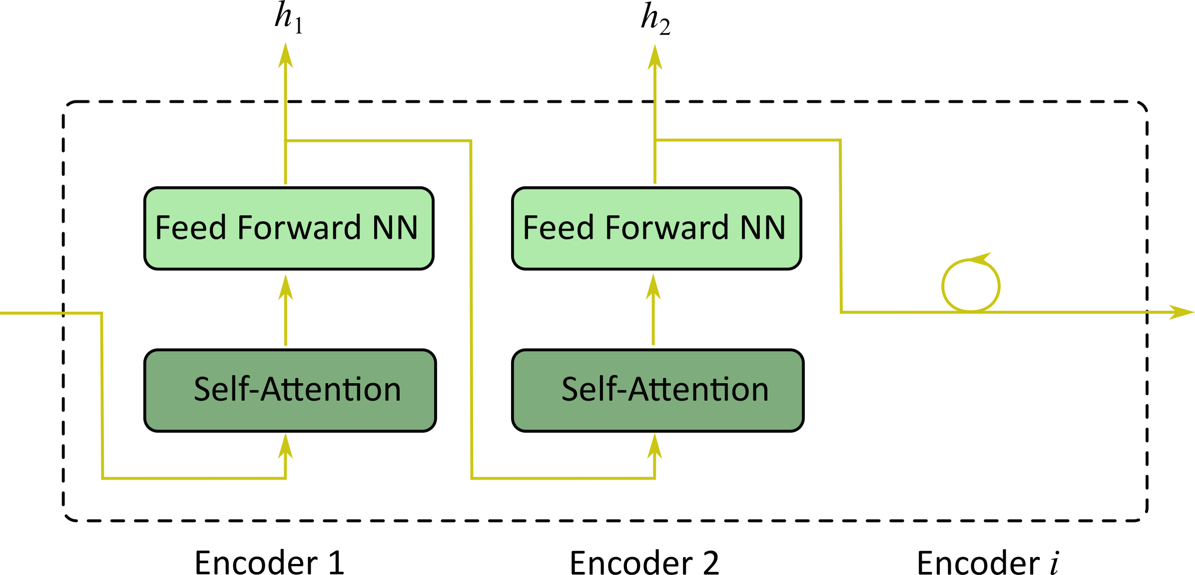
Self-Attention in Natural Language Processing
Encoder Stack
Encoder: Stacked ANN
Sequence of hidden features captures the encoder context building stack
Decoder: Stacked ANN

Slide 21
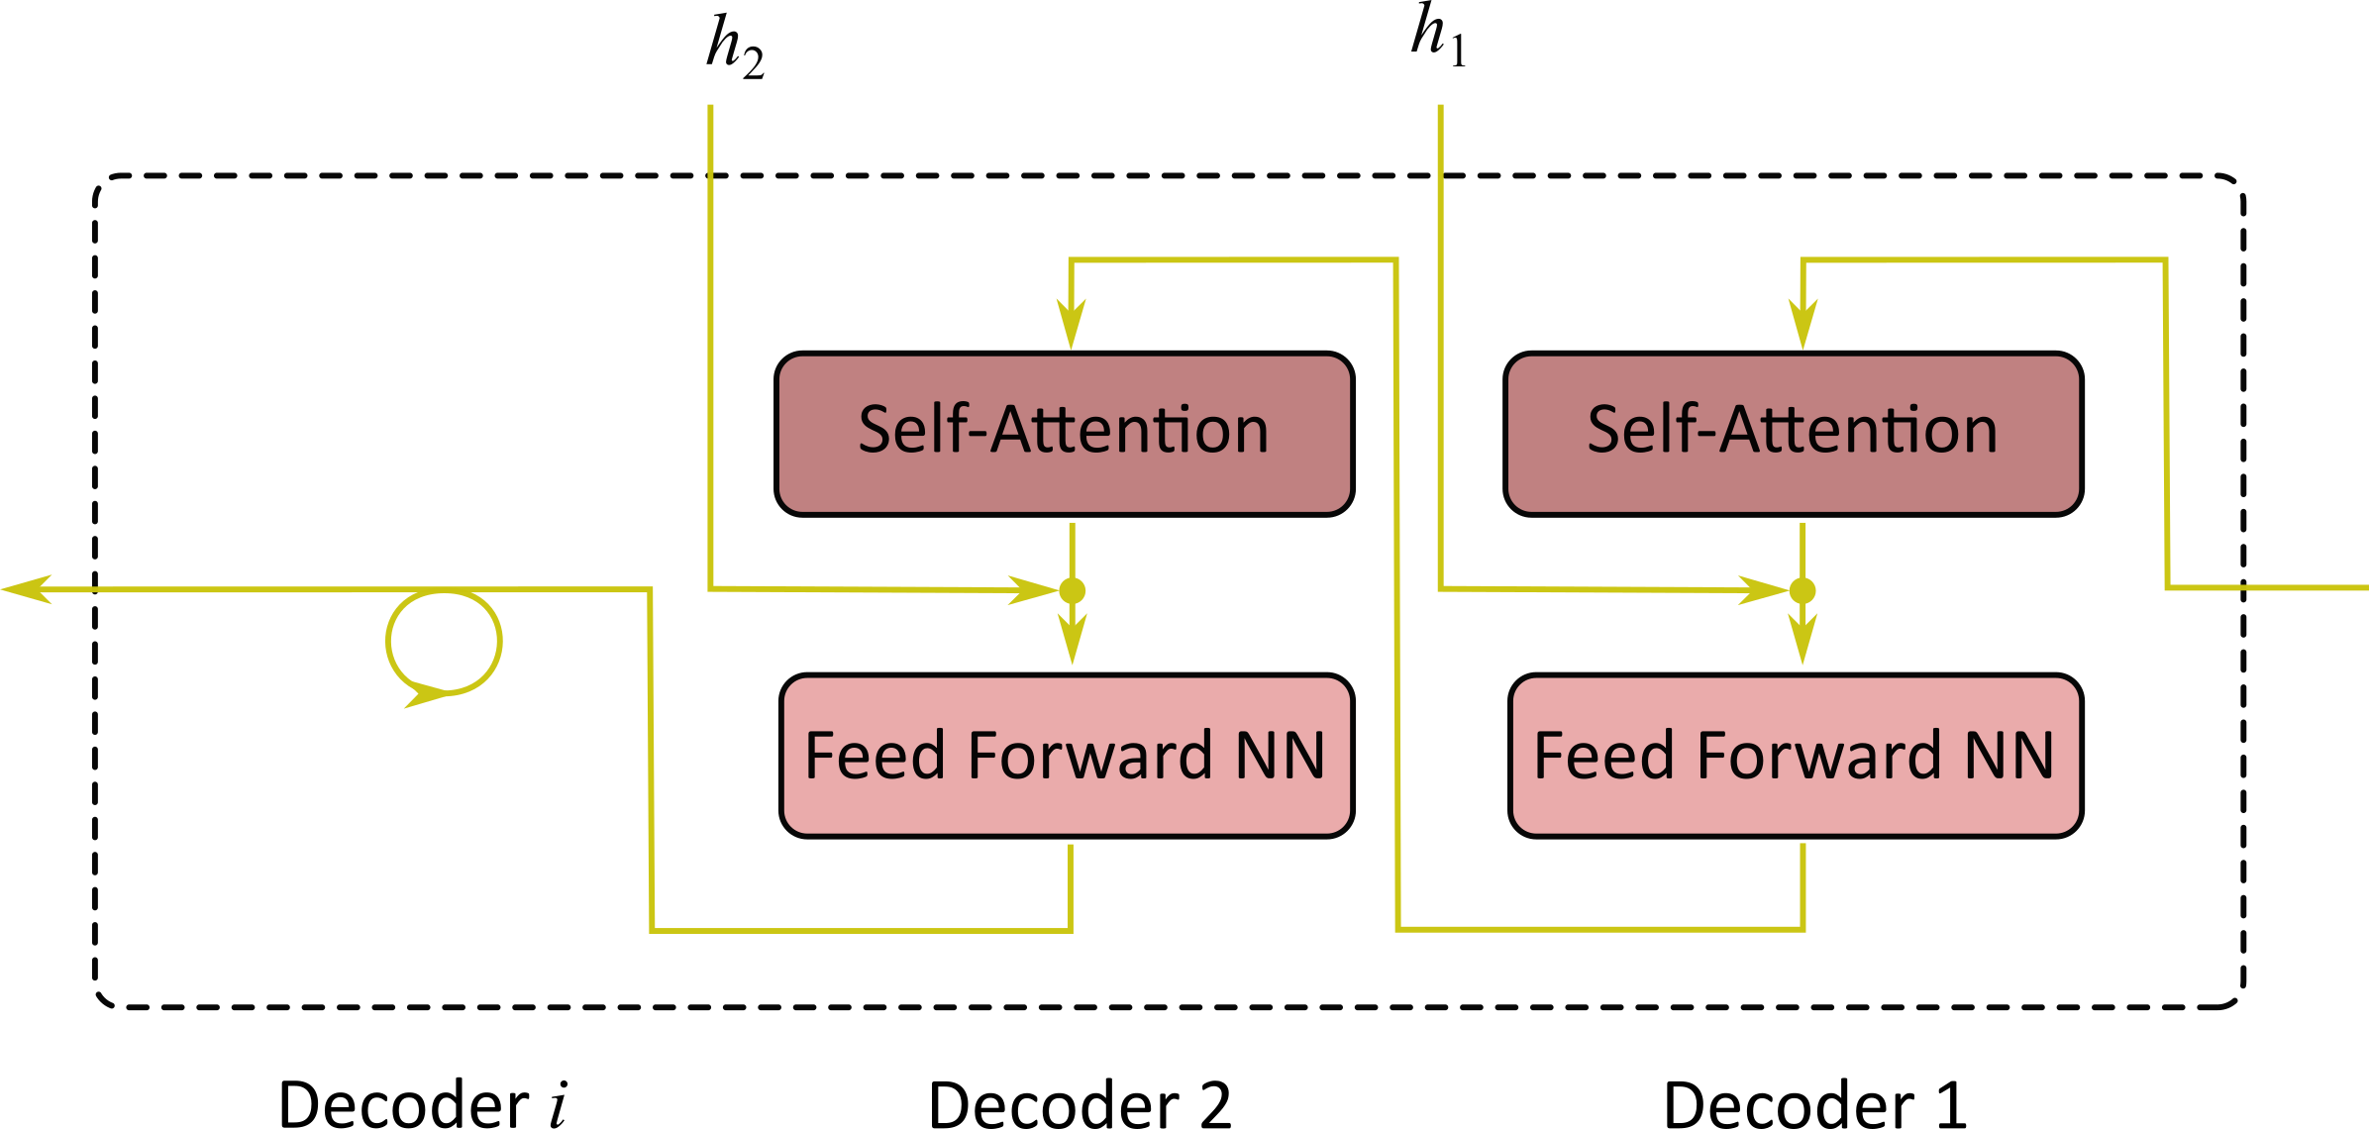
Self-Attention in Natural Language Processing
Decoder Stack
Encoder: Stacked ANN
Sequence of hidden features captures the encoder context building stack
Decoder: Stacked ANN
Multi-Step Attention unrolls the context stack to the decoder

Slide 22
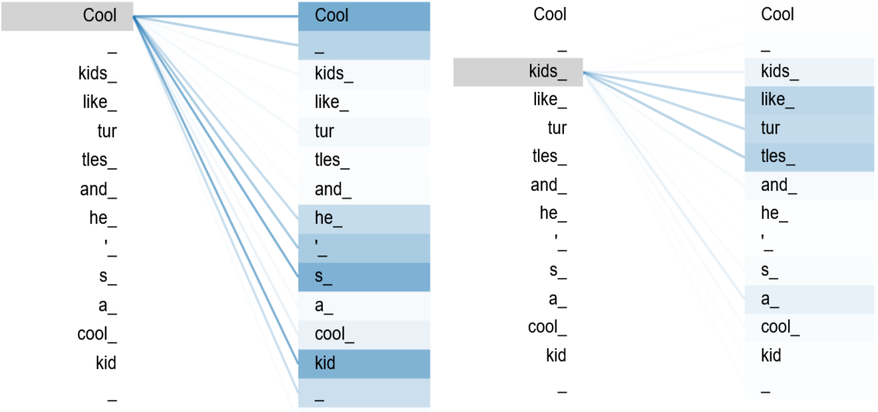
Self-Attention in Natural Language Processing
Self-Attention
Encoder: Stacked ANN
Sequence of hidden features captures the encoder context building stack
Decoder: Stacked ANN
Multi-Step Attention unrolls the context stack to the decoder
------ Self-attention aggregates context dependencies within the inputs

Slide 23
Summary
#1
Human Perception is based on the dynamics between selection and recognition
#3
The incorporation of context provides dynamic features that are context specific and therefore improve the model perfomance
#2
Attention machanisms immitate this behaviour by using intermediate states, that entangle context with semantic information
#4
After all - attention mechanisms can also help to understand the decisions of deep networks

Slide 24
Summary
#1
Human Perception is based on the dynamics between selection and recognition
#3
The incorporation of context provides dynamic features that are context specific and therefore improve the model perfomance
#2
Attention machanisms immitate this behaviour by using intermediate states, that entangle context with semantic information
#4
After all - attention mechanisms can also help to understand the decisions of deep networks

Slide 25
Summary
#1
Human Perception is based on the dynamics between selection and recognition
#3
The incorporation of context provides dynamic features that are context specific and therefore improve the model perfomance
#2
Attention machanisms immitate this behaviour by using intermediate states, that entangle context with semantic information
#4
After all - attention mechanisms can also help to understand the decisions of deep networks

Slide 26
Summary
#1
Human Perception is based on the dynamics between selection and recognition
#3
The incorporation of context provides dynamic features that are context specific and therefore improve the model perfomance
#2
Attention machanisms immitate this behaviour by using intermediate states, that entangle context with semantic information
#4
After all - attention mechanisms can also help to understand the decisions of deep networks

Slide 27
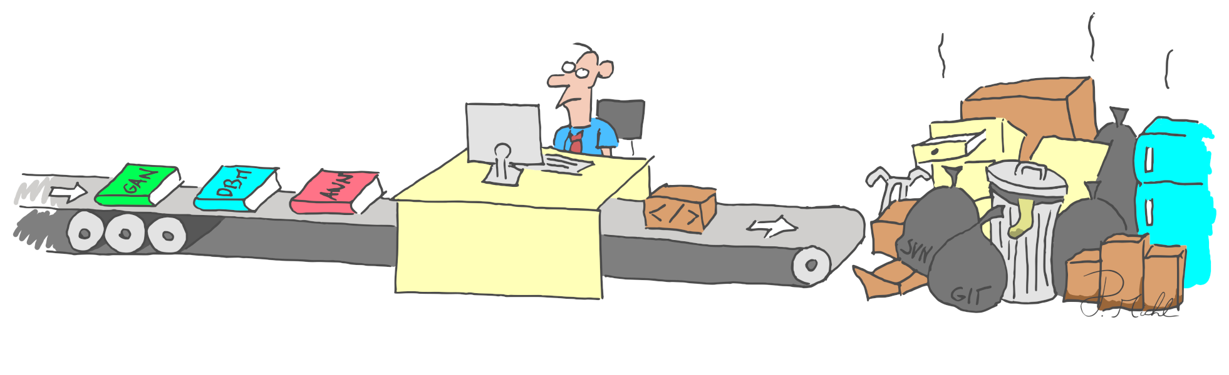
Thank you for your attention!

